Slide 1

Introduction to Arduino
An Overview of Arduino Microcontroller
By Purushottam Mahajan SE Div A Roll No - 74

Slide 2

What is arduino?
Arduino is an open-source electronics platform based on easy-to-use hardware and software. It consists of a microcontroller board and a development environment for writing, programming, and uploading code to the board.
Arduino boards are able to read inputs—light on a sensor, a finger on a button, or a Twitter message—and turn it into an output—activating a motor, turning on an LED, publishing something online. It can be used to create interactive objects or environments, such as controlling lights, motors, and sensors, and building prototypes for various electronic projects.
Arduino's simplicity and versatility make it popular among hobbyists, students, educators, and professionals alike for a wide range of applications, including robotics, home automation, wearable technology, and Internet of Things (IoT) projects.

Slide 3
History of Arduino
The history of Arduino began in 2003 at the Interaction Design Institute Ivrea in Italy. A group of researchers, including Massimo Banzi, David Cuartielles, David Mellis, Tom Igoe, and Gianluca Martino, sought to create an easy-to-use and affordable platform for students and non-engineers to prototype interactive projects.
In 2005, the team developed the first Arduino board, named the Arduino Serial, based on the Atmel ATmega8 microcontroller. This board featured a standard USB connection for programming and power, making it accessible to a wide range of users.
The Arduino project gained momentum with the introduction of the Arduino Diecimila in 2007, which featured an ATmega168 microcontroller and automatic reset circuitry. This version of Arduino became widely popular due to its enhanced capabilities and ease of use.

Slide 4
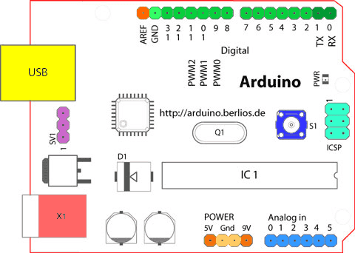
Components of Arduino
1. Microcontroller: The heart of the Arduino board, responsible for executing program instructions and controlling input/output operations.
2.Input/Output (I/O) Pins: These pins allow communication between the microcontroller and external devices such as sensors, actuators, LEDs, and displays.
3.Power Supply: Arduino boards can be powered through various means, including USB connection, external power supply, or battery.
4.USB Interface: Most Arduino boards feature a built-in USB interface for programming the board and serial communication with a computer.
5.Reset Button: A reset button allows users to restart the Arduino board, resetting the microcontroller and restarting the execution of the program.

Slide 5
Components of Arduino
6.Crystal Oscillator: Arduino boards typically include a crystal oscillator or resonator to provide a stable clock signal for timing operations performed by the microcontroller.
7. LEDs: Many Arduino boards include built-in LEDs that serve as indicators for various purposes, such as power status, communication activity, and user-defined output.
8.Voltage Regulator: Arduino boards often feature voltage regulators to regulate the input voltage to the appropriate level required by the microcontroller and other components on the board.
9. Headers and Connectors: Arduino boards include headers and connectors for easy connection of external components, such as sensors, actuators, shields, and expansion boards.

Slide 6
Applications of Arduino
Electronics Prototyping: Arduino is widely used for prototyping electronic projects due to its ease of use and versatility. It allows users to quickly test ideas and create proof-of-concept prototypes before moving to production.
Robotics: Arduino is extensively used in robotics projects for controlling motors, sensors, and actuators. It is suitable for building various types of robots, from simple hobby robots to advanced robotic systems.
Home Automation: Arduino is used to create custom home automation systems for controlling lights, appliances, thermostats, and security devices
Wearable Technology: Arduino is used in the development of wearable devices such as fitness trackers, smartwatches, and health monitoring systems.
Internet of Things (IoT): Arduino is a popular platform for building IoT projects, enabling devices to connect to the internet and communicate with each other. It is used in applications such as smart home systems, environmental monitoring, industrial automation, and asset tracking.

Slide 7
Advantages
Ease of Use: Arduino is designed to be beginner-friendly, with a simple programming language and an easy-to-use development environment. This makes it accessible to people with little or no programming experience.
Affordability: Arduino boards are relatively inexpensive compared to other microcontroller platforms, making them accessible to hobbyists, students, and educators on a tight budget.
Versatility: Arduino boards can be used for a wide range of applications, from simple LED blinking projects to complex robotics and IoT projects. They can be easily expanded and customized using shields and modules.
Open Source: Arduino is an open-source platform, which means that its hardware designs, software IDE, and libraries are freely available for modification and distribution. This encourages collaboration and innovation within the Arduino community.
Large Community: Arduino has a large and active community of users, developers, and enthusiasts who share knowledge, tutorials, and projects online. This provides valuable support and resources for beginners and experienced users alike.

Slide 8
Limitations
Processing Power: Arduino boards are based on microcontrollers with limited processing power compared to more powerful microprocessors. This can be a limitation for complex projects requiring high computational performance.
Memory Limitations: Arduino boards have limited program memory (flash) and RAM, which can restrict the size and complexity of programs that can be run on them. This can be a limitation for projects with large codebases or requiring extensive data storage.
Limited Connectivity: While Arduino boards support various communication protocols such as UART, SPI, and I2C, they may lack built-in connectivity options such as Wi-Fi or Bluetooth. Additional modules or shields are required for wireless communication, adding cost and complexity to projects.
Real-Time Constraints: Arduino's real-time capabilities are limited by its single-threaded execution model and lack of a real-time operating system (RTOS). This can be a limitation for applications requiring precise timing or multitasking.

Slide 9
Thank You!

